Slide 1









Whiteboardmaths.com
7
2
1
5
© 2004 All rights reserved

Slide 2
Whiteboardmaths.com
7
2
1
5
© 2004 All rights reserved

Slide 3


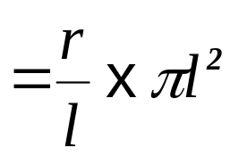


The Curved Surface Area of a Cone
CONE
Fraction of circle of radius l
Area of circle of radius l
l
Slope height
r

l
SECTOR
Curved Surface area of cone = area of sector
2πr

Slide 4
The Curved Surface Area of a Cone
Example Questions: Find the curved surface areas of the cones below. (to 1 dp)
1
πrl
2
4.8 cm
15 cm
6 cm
3.1 cm
Surface area = π x 6 x 15
= 282.7 cm²
Surface area = π x 3.1 x 4.8
= 46.7 cm²
Not to SCALE

Slide 5
The Curved Surface Area of a Cone
Questions: Find the curved surface areas of the cones below. (to 1 dp)
1
πrl
2
7.3 m
19 cm
7 cm
5.2 m
Surface area = π x 7 x 19
= 417.8 cm²
Surface area = π x 5.2 x 7.3
= 119.3 m²
Not to SCALE

Slide 6
worksheet

